Slide 1
ITEC 101 FUNDAMENTALS OF IT
DANIEL OBUOBI, DCSIT,CU
SYSTEM SOFTWARE, APLICATION SOFTWARE etc

Slide 2
System Software
Operating systems
Control computer functions:
Hardware
Memory
Application programs
System maintenance
Provide user interface
System utilities
Programs that perform computer housekeeping tasks:
Manage system resources
Improve efficiency
Virus prevention
Notes:
There are two basic types of software: application software and system software.
--Application software is the software you use to do everyday tasks at home and at work.
--System software is the set of software programs that helps run the computer and coordinates instructions between application software and the computer’s hardware devices.
System software consists of two primary types of programs: the operating system and utility programs.
--The operating system (OS) is the main program that controls how your computer system functions. The OS manages the computer’s hardware, including the processor, memory, and storage devices, as well as peripheral devices. The operating system also provides a consistent means for software applications to work with the CPU. Additionally, it is responsible for the management, scheduling, and interaction of tasks. Your first interaction with the OS is the user interface.
--System software also includes utility programs. These are small programs that perform many of the general housekeeping tasks for the computer, such as system maintenance and file compression.

Slide 3
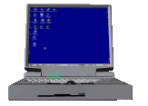
Operating System Categories
Four categories:
Real-Time (RTOS)
Single-User, Single-Task
Single-User, Multitask
Multi-user
Notes:
Operating systems can be classified into four categories, depending on the number of users they service and the tasks they perform.
Real-time operating systems don’t require the intervention of any users at all.
Single-user, single-task operating systems are proprietary systems developed specifically for the devices they manage.
Single-user, multitask operating systems are available commercially, for personal and business use.
Multiuser operating systems coordinate resources for many users on a network.

Slide 4

Real-Time Operating Systems
Systems with a specific purpose and a certain result
Uses include:
Industrial machines
Robotic equipment
Automobiles
Video game consoles
Home appliances
Minimal or no user interaction is required.
Notes:
Machinery that is required to perform a repetitive series of specific tasks in an exact amount of time requires a real-time operating system.
This type of operating system is a program with a specific purpose.
For example, instruments such as those found in the scientific, defense, and aerospace industries that must perform regimented tasks or record precise results require real-time operating systems.
Real-time operating systems are also found in many types of robotic equipment, fuel-injection systems in car engines, video game consoles, and many home appliances.
Real-time operating systems require minimal user interaction. The programs are written specifically to the needs of the devices and their functions. Therefore, there are no commercially available standard RTOS software programs.

Slide 5
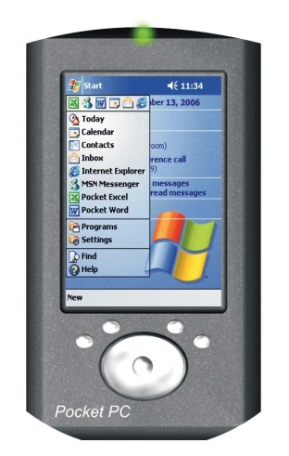
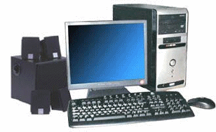
Single-User Operating Systems
Single-task systems
Perform one task at a time
PDAs:
Pocket PC
Palm OS
MS-DOS
Multitask systems
Perform simultaneous tasks
Windows
MAC OS
Linux
Notes:
All computers on which one user is performing just one task at a time require a single-user, single-task operating system. PDAs currently can perform only one task at a time by a single user, so they require single-user, single-task operating system software such as Pocket PC or Palm OS..
Microsoft Disk Operating System (MS-DOS) is another example of a single-user, single-task operating system.
Because your computer can handle only one person working on it at a time but can perform a variety of tasks simultaneously, it uses a single-user, multitask operating system. Windows operating systems and the Macintosh operating system (Mac OS) are most commonly used as single-user multitask operating systems.

Slide 6
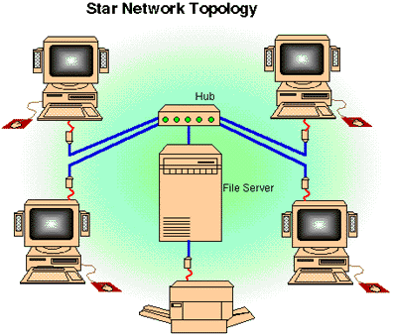
Multi-user Operating Systems
Known as network operating systems
Allow access to the computer system by more than one user
Manage user requests
Systems include:
UNIX
Novell Netware
Windows Server 2003
Notes:
A multiuser operating system (also known as a network operating system) enables more than one user to access the computer system at one time by efficiently juggling all the requests from multiple users.
Networks require a multiuser operating system because many users access the server computer at the same time and share resources. A network operating system is installed on the server and manages all user requests, ensuring they do not interfere with each other.
Examples include Linux, UNIX, Novell NetWare, and Windows Server 2003

Slide 7


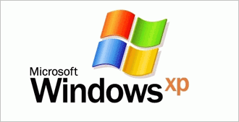
Desktop Operating Systems
Operating system combined with the processor is known as a platform
Microsoft Windows / Intel
Apple Macintosh / Motorola
Desktop operating systems include:
Microsoft Windows
MAC OS
UNIX
Linux
Notes:
The combination of operating system and processor is referred to as a computer’s platform.
For example, Microsoft Windows operating systems are designed to coordinate with a series of processors from Intel Corporation and AMD (Advanced Micro Devices) that share the same or similar sets of instructions. However, Apple Macintosh operating systems work primarily with processors from Motorola and IBM designed specifically for Apple computers.
The three most used desktop operating systems are Windows, Mac OS, and Linux.

Slide 8
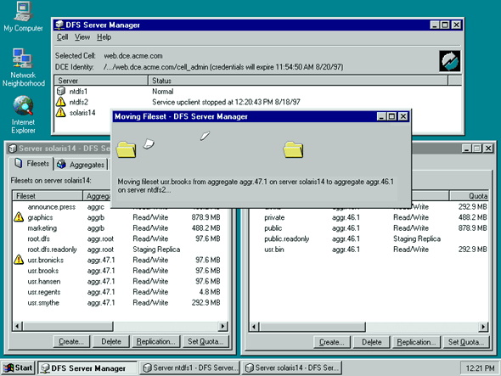
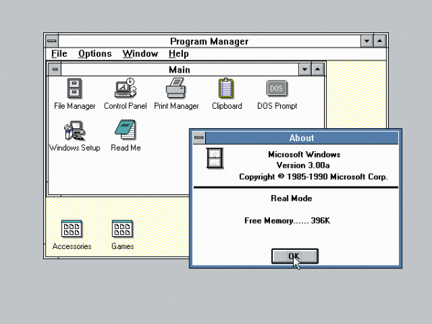
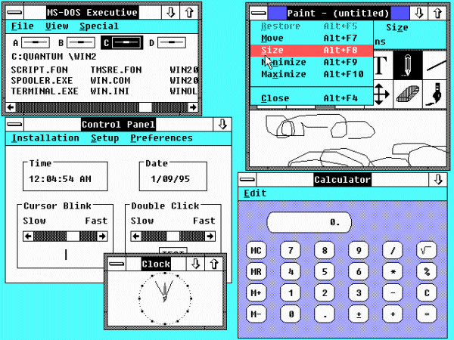
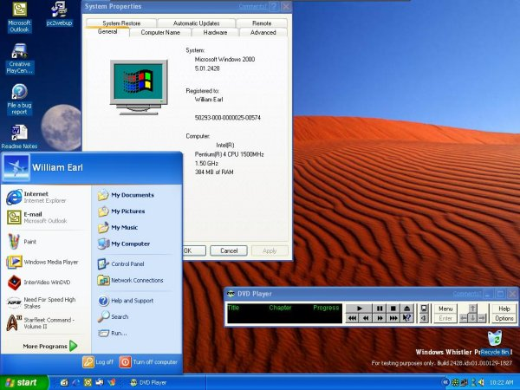
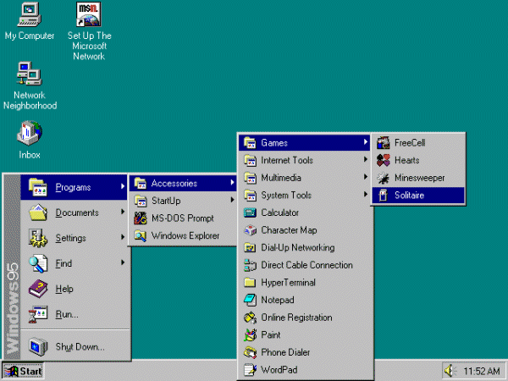
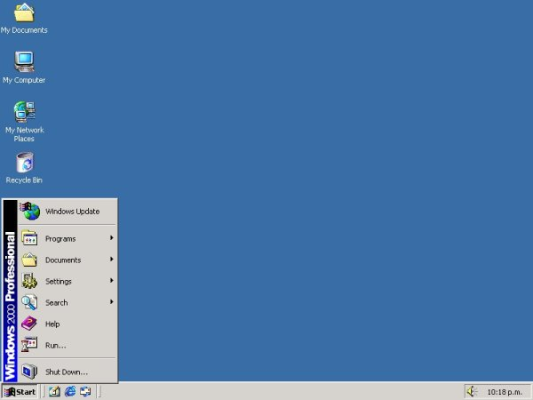
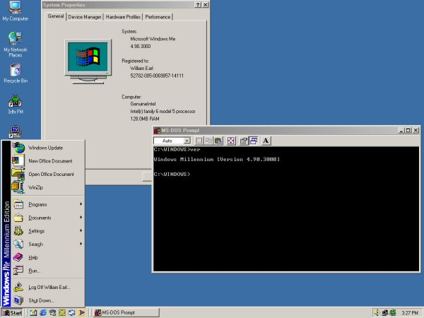
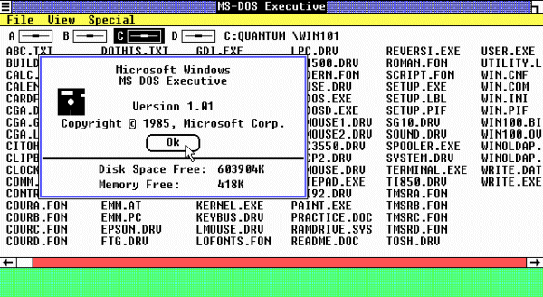
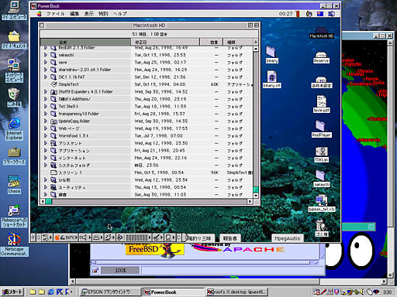
Microsoft Windows
Market leader – 90% market share
Click to view the various Windows systems
Fundamentally different operating system with increased security, power,
performance, and multitasking scheduler.
First widely used PC graphical user interface (GUI) operating system. Improved
point-and-click mouse operations and multitasking capabilities.
Introduces point-and-click commands with a mouse and includes modest
multitasking capabilities and desktop applications.
This operating system runs faster
and more efficiently, introduces Plug and Play capabilities, long file names, short-cut
right-click menus, and a cleaner desktop.
Includes better graphics capabilities and introduces keyboard shortcuts and
the ability to overlap windows.
This upgrade to Windows 95 and Windows 98 includes system backup and
multimedia capabilities (such as Media Player).
This upgrade to Windows NT offers improvements to file security and Internet support.
This upgrade includes additional file protection and incorporates
Internet Explorer 4.0, a customizable taskbar, and desktop features
Offers a new multi-user desktop as well as improved digital media features and
Internet capabilities.
Windows XP (2001)
Windows ME (2000)
Windows 2000 (2000)
Windows 98 (1998)
Windows NT (1993)
Windows 95 (1995)
Windows 3.x (1990-1992)
Windows 2.0 (1987)
Windows 1.0 (1985)
Notes:
Microsoft Windows is the market leader in operating system sales, maintaining an approximate 90 percent market share.
Although Windows XP is the most recent version on the market, many computers still run earlier versions, such as Windows 95, Windows NT, Windows 98, Windows Millennium Edition (Me), and Windows 2000.
Windows XP comes in a number of versions, including Windows XP Home Edition, Windows XP Professional, Windows XP Tablet PC, and Windows XP Media Center Edition.
Windows came under development soon after the Apple Macintosh introduced the graphical user interface in 1984. In fact, Microsoft was sued by Apple for stealing the “look and feel” of their operating system, a suit Apple eventually lost.

Slide 9
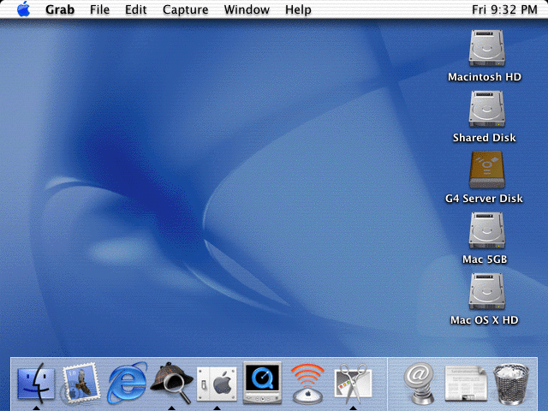
MAC OS
First operating system with point-and-click technology (Graphical User Interface)
Excellent in:
Graphics display
Processing capabilities
System reliability
Document recovery
Fewer software applications
MAC OS X
Notes:
Although Apple’s Mac OS and the Windows operating systems are not compatible, they are similar in terms of functionality.
In 1984, Mac OS became the first operating system to incorporate the user-friendly point-and-click technology in a commercially affordable computer. Both operating systems now have similar window work areas on the desktop that house individual applications and support users working in more than one application at a time
Macs have long been recognized for their superior graphics display and processing capabilities. Users also attest to Mac’s greater system reliability and better document recovery.
However, there are fewer software applications available for the Mac platform and Macs tend to be more expensive than Windows-based PCs.
The most recent version of the Mac operating system, Mac OS X, is based on the UNIX operating system.

Slide 10
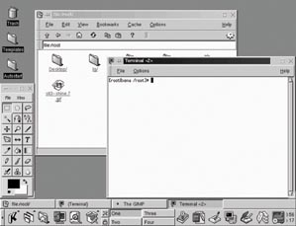
UNIX
Multi-user, multitask operating system
Used primarily with mainframes
Notes:
UNIX is a multi-user, multitask operating system used primarily with mainframes as a network operating system, although it is also often found on PCs.
Originally conceived in 1969 by Ken Thompson and Dennis Ritchie of AT&T’s Bell Labs, the UNIX code was initially not proprietary. Rather, any programmer was allowed to use the code and modify it to meet his or her needs.
Later, AT&T licensed the UNIX source code to the Santa Cruz Operation. UNIX is a brand that belongs to the company X/Open, but any vendor that meets testing requirements and pays a fee can use the UNIX name.
Individual vendors then modify the UNIX code to run specifically on their hardware. HP/UX from Hewlett-Packard, Solaris from Sun, and AIX from IBM are some of the UNIX systems currently available in the marketplace.

Slide 11
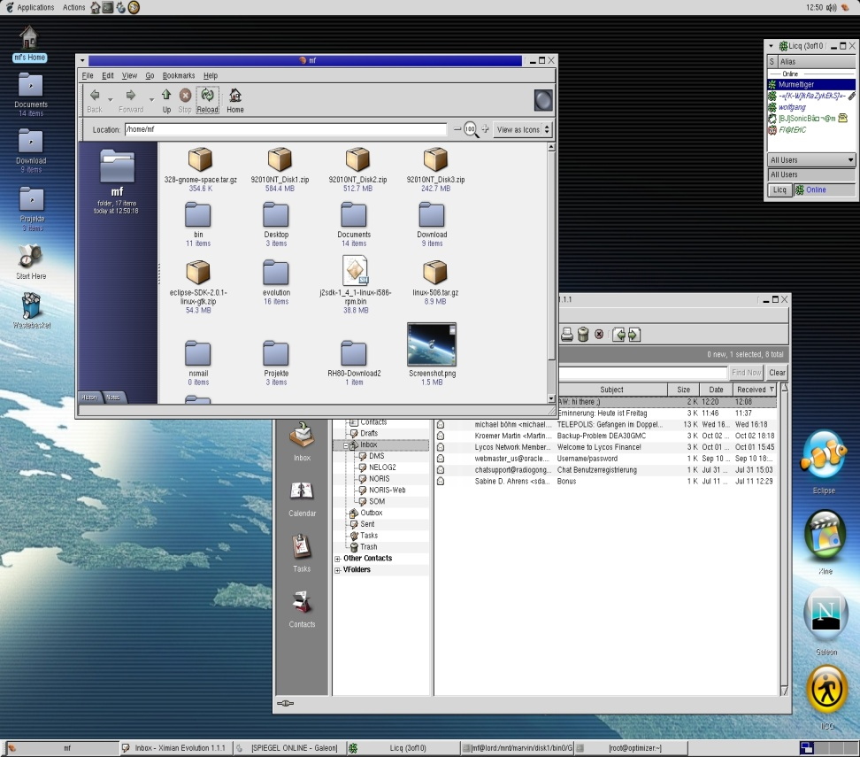
Linux
Open-source operating system
Based on UNIX
Stable system
Free
May be downloaded through the Internet
Notes:
In 1991 a Finnish graduate student named Linus Torvalds decided he would create a Unix-like operating system that would run on an Intel processor. His product, called Linux, was offered for free to developers around the world and has been upgraded and improved continually since then.
Linux is open-source software, meaning that anyone can obtain the code for free and alter it. The agreement is that improvements and methods will also be shared.
Today, Linux is gaining a reputation as a stable operating system that is not subject to crashes and failures.
You can download the open-source versions of Linux for free off the Internet. However, there are several versions of Linux that are more proprietary in nature. These versions come with support and other products not generally associated with the open-source Linux. Red Hat has been packaging and selling versions of Linux since 1994 and is probably the most well-known Linux distributor.
Linux is gaining ground in many markets but still is a long way from rivaling Microsoft on the desktop.
Linux is a robust, stable OS, preferred by Internet Service Providers. Companies like IBM and HP have huge Linux projects and sell Linux-based solutions. There are companies like Red Hat who sell versions of Linux that are loaded with utilities and capabilities, including full-blown technical support. Because the source code is free, Red Hat can sell enterprise-scale software at a substantial savings to corporations, while offering the same level of service and support that these companies would get from Microsoft.
Linux is gaining ground in many markets, but still is a long way from rivaling Microsoft on the desktop.

Slide 12
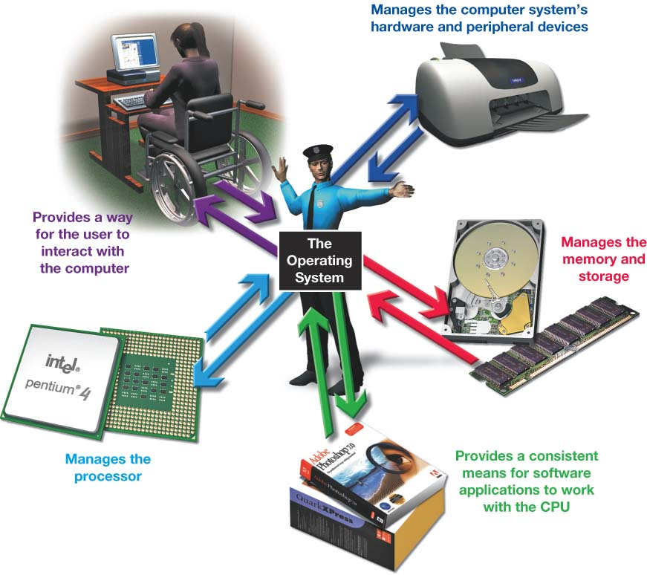
What the Operating System Does
Provides user interface
Manages the CPU
Manages memory
Manages hardware
Coordinates application software with the CPU
Notes:
The operating system performs several specific functions:
It provides a way for the user to interact with the computer.
It manages the processor, or central processing unit (CPU).
It manages the memory and storage.
It manages the computer system’s hardware and peripheral devices.
It provides a consistent means for software applications to work with the CPU.

Slide 13
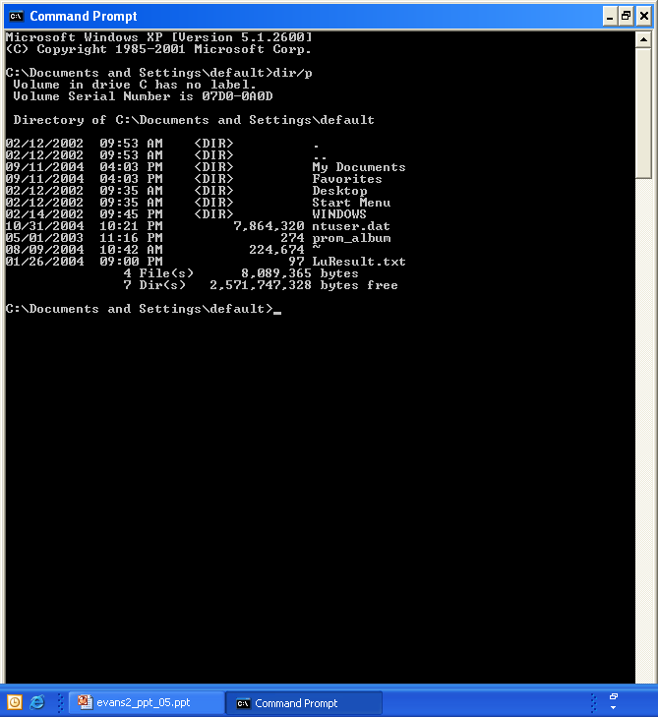
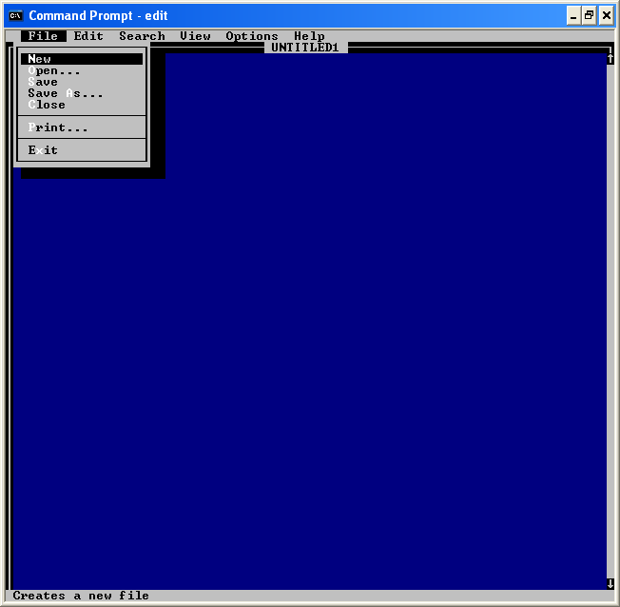
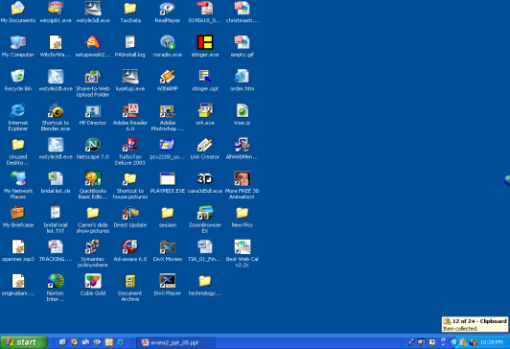
The User Interface
Enables you to interact with the computer
Types of interfaces:
Command-driven interface
Menu-driven interface
Graphical user interface
Command-line
Menu-driven
Graphical
Notes:
The operating system provides a user interface that enables you to interact with the computer.
In early PCs, the interface with the operating system was through a command-driven interface, meaning that the user had to type very specific commands to get the computer to load a program. The commands were not always easy to understand and therefore the interface proved to be too complicated for the average user.
The command-driven interface was later improved by incorporating a menu-driven interface in which you choose a command from menus displayed on the screen. Menu-driven interfaces eliminated the need to know every command because you could select most of the commonly used commands from a menu. However, they were still not easy enough for most people to use.
Most operating systems today use a graphical user interface. Unlike the command- and menu-driven interfaces used earlier, GUIs display graphics and use the point-and-click technology of the mouse and cursor, making them much more user friendly.

Slide 14
Processor Management
Controls the timing of events the processor works on
Interrupts
Interrupt handler
Interrupt table
Stack
Operating System
Process 3rd
Process 1st
Process 4th
Process 2nd
REQUEST
Notes:
Although the CPU is the brains of the computer, it needs the OS to arrange for the execution of all its activities in a systematic way.
To do so, the OS assigns a slice of its time to each activity requiring the CPU’s attention. The OS then switches between processes thousands of times a second so it appears that everything is happening seamlessly.
When the OS allows you to perform more than one task at a time, it is said to be multitasking.
For example, assume you’re typing and you want to print a file. When you tell your computer to print the file, the printer generates a signal called an interrupt that tells the OS it is in need of attention.
Every device has its own type of interrupt, which is associated with an interrupt handler, a special numerical code that prioritizes the requests. These requests are placed in the interrupt table in RAM.
In our example, the OS pauses the CPU from its typing activity when it receives the interrupt from the printer and puts a “memo” in a special location in RAM called a stack. The memo is a reminder of where the CPU was before it left off so that it can work on the printer request.
The CPU then retrieves the printer request from the interrupt table and begins to process it. Upon completion of the printer request, the CPU goes back to the stack, retrieves the memo it placed about the typing activity, and returns to that task until it is interrupted again.

Slide 15
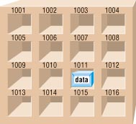
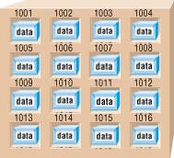
Memory Management
The operating system allocates space in RAM for instructions and data
RAM
Operating System
Notes:
As the OS coordinates the activities of the processor, it uses RAM as a temporary storage area for instructions and data the processor needs.
The processor then accesses these instructions and data from RAM when it is ready to process them.
The OS is therefore responsible for coordinating the space allocations in RAM to ensure that there is enough space for all the waiting instructions and data.
It then clears the items from RAM when the processor no longer needs them.

Slide 16
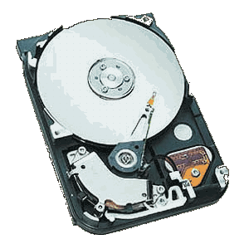
Virtual Memory
Instructions and data are stored on the hard drive when RAM is full
Swap file
Paging
Thrashing
FULL
Operating System
Notes:
RAM has limited capacity. When there isn’t enough room in RAM for the OS to store the required data and instructions, it borrows room from the hard drive.
This process of optimizing RAM storage by borrowing hard drive space is called virtual memory.
When more RAM space is needed, the OS swaps out from RAM the data or instructions that have not been recently used and moves them to a temporary storage area on the hard drive called the swap file.
If the data and/or instructions in the swap file are needed later, the OS swaps them back into active RAM and replaces them in the hard drive’s swap file with less-active data or instructions. This process of swapping is known as paging.
Eventually your computer will become sluggish as it is forced to page more and more often. This condition of excessive paging is called thrashing.
The solution to this problem is to increase the amount of RAM in your system so that you can avoid it having to send data and instructions to virtual memory.

Slide 17
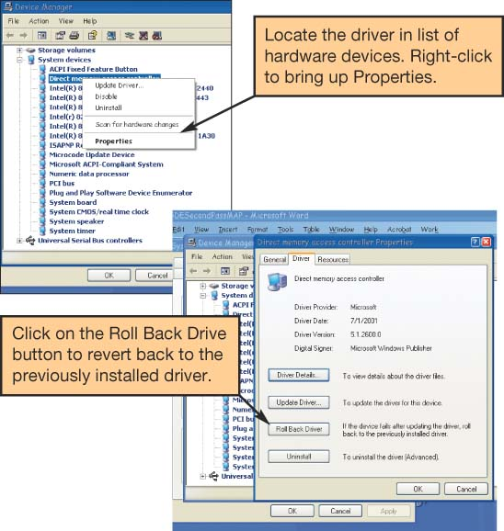
Hardware Management
Device drivers:
Programs that enable the operating system to communicate with peripheral devices
Provided by the manufacturer of the device
Plug and Play:
Hardware and software standard
Facilitates the installation of new hardware
Notes:
Each device attached to your computer comes with a special program called a device driver that facilitates the communication between the device and the OS.
The device driver translates the specialized commands of the device to commands that the OS can understand, and vice versa. Thus, devices will not function without the proper device driver because the OS would not know how to communicate with them.
Today, most devices come with the driver already pre-installed in Windows. The devices whose drivers are included in Windows are called Plug and Play (PnP).
However, Plug and Play is not a driver. Instead, it is a software and hardware standard designed to facilitate the installation of a new piece of hardware in computers by including the driver the device needs to run into the OS.
Plug and Play enables users to plug in their new device to a port on the system, turn on the system, and immediately use the device. The OS automatically recognizes the device and its driver.

Slide 18
Software Application Coordination
Application programming interfaces (APIs):
Blocks of code contained in the operating system
Coordinates the operating system with software applications
Similar toolbars and menus
Microsoft Direct X
Notes:
For software programs to work with the CPU, they must contain code that the CPU recognizes. Rather than having the same blocks of code for similar procedures in each software application, the OS includes the blocks of code that software applications need.
These blocks of code are called application programming interfaces (APIs).
To create programs that can communicate with the operating system, software programmers need only refer to the API code blocks in their individual application programs, rather than including the entire code in the application itself. Not only do APIs avoid redundancies in software code, they also make it easier for software developers to respond to changes in the OS.
Microsoft DirectX, for example, is a group of multimedia APIs built into the Windows operating system that improves graphics and sounds when you’re playing games or watching video on your PC.

Slide 19
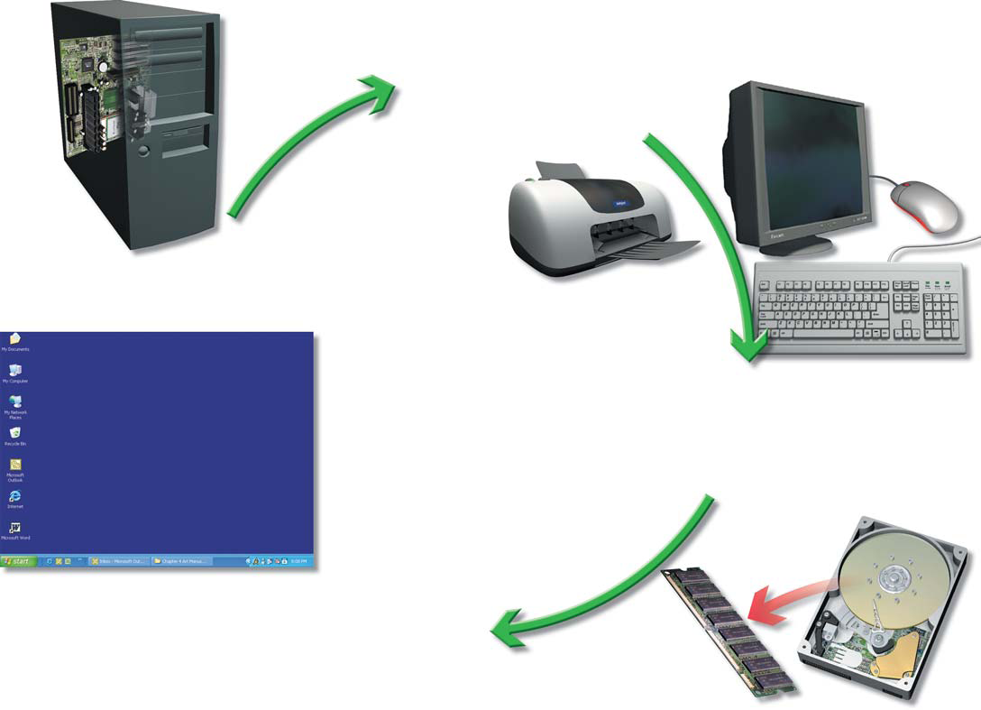
Starting the Computer
The Boot Process
Step 1: The basic input/output system (BIOS) is activated
Step 2: A Power-on-self-test (POST) checks attached hardware
Step 3: The operating system loads into memory
Step 4: Configuration and customization settings are checked
2
1
3
4
Notes:
For a computer to go from a dead stop to ready-for-use, a four step start-up process is required. This is often referred to as booting up the computer, or the boot process. The boot process consists of four basic steps:
1. The basic input/output system (BIOS) is activated by powering on the CPU.
2. The BIOS checks that all attached devices are in place (called a power- on self-test, or POST).
3. The operating system is loaded into RAM.
4. Configuration and customization settings are checked.
Once the boot process has completed these steps, it is ready to accept commands and data.

Slide 20
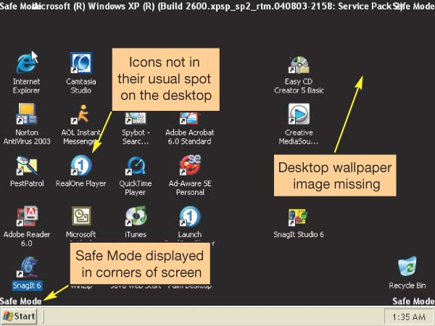
Handling Errors in the Boot Process
Non-system disk or disk error
Remove the floppy from the drive and press any key
POST errors
Single beep: Everything is loading properly
Series of beeps: Hardware problem
Safe mode
Windows does not boot properly
Uninstall any new devices or software
Notes:
Errors during the boot process are often very simple to correct and it is helpful to be aware of the most common problems.
Many computers are set to look on the floppy drive first for an operating system. This method allows for booting the system if the hard drive goes bad. Normally, when the computer finds no disk in the floppy drive, it looks to the hard drive and boots from there. If you leave a diskette in the drive that does not have system files on it, the computer will display a message that there is a “non-system disk.” Removing the diskette will solve the problem.
During POST, the BIOS looks for a video out connection and a keyboard in connection. If either is missing the boot process is halted and a series of beeps will be heard. The solution is to check your keyboard connection and video card to make sure something didn’t become disconnected.
Sometimes Windows does not boot properly and you end up with a screen with the words Safe Mode in the corners. Safe mode is a special diagnostic mode designed for troubleshooting errors. While in Safe mode, only the essential devices of the system (such as the mouse, keyboard, and monitor) function. If, after you boot, you end up in Safe mode, try rebooting the machine before doing anything else. If you still end up in Safe mode and if you have recently installed new software or a new hardware device, try uninstalling it.

Slide 21
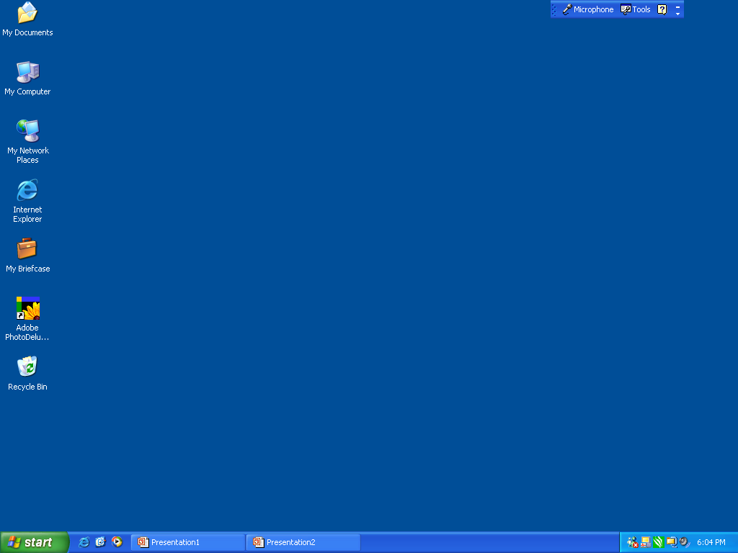
The Desktop
Click to view Desktop features
B
MY DOCUMENTS
I
____________
Desktop features:
Shortcut icons
My Documents
Start button
Quick launch
Open programs
Taskbar
System tray
toolbar
TOOLBAR
C
_________
MY COMPUTER
____________
A
_______________
SHORT CUT ICONS
OPEN PROGRAMS
__________________
___________
D
_________
SYSTEM TRAY
____________
TASKBAR
START BUTTON
F
G
H
E
QUICKLAUNCH
____________
Notes:
The desktop is the first interaction you have with the OS and the first image you see on your monitor. As its name implies, your computer’s desktop puts at your fingertips all of the elements necessary for a productive work session that are typically found on or near the top of a traditional desk, such as files and folders.
The parts of the desktop are listed here. Try to name them before the mouse is clicked.

Slide 22
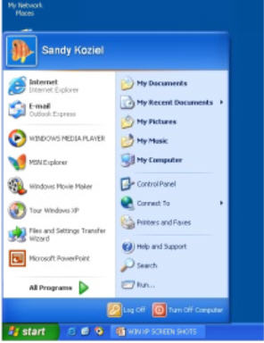
Start Menu
Click to view Start menu features
A
USER NAME
____________
B
PINNED ITEMS LIST
_______________
_______________
_______________
_______________
G
SPECIAL FOLDERS
SYSTEM AREA
HELP
MOST FREQUENTLY
USED LIST
_______________
C
ALL PROGRAMS
BUTTON
D
F
___________
SHUT DOWN/RESTART
_______________
_____________
E
USER LOG OFF
Notes:
The Start menu is found by clicking on the lower left button on the screen. From it, you can reach all parts of the software system. Try to identify the parts of the Start menu before the mouse is clicked.

Slide 23
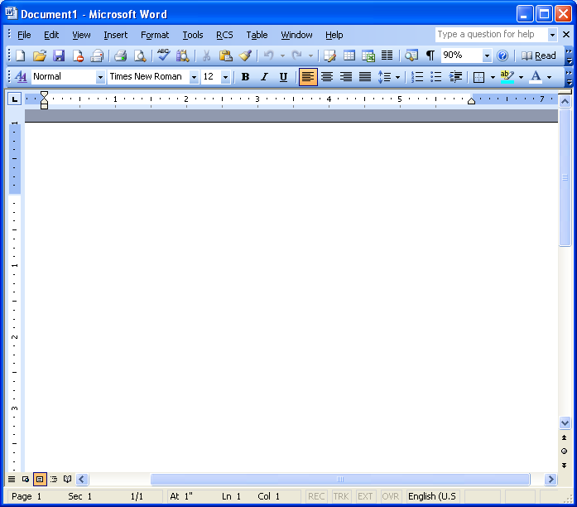
Window
Click to view Window features
__________
A
TITLE BAR
__________
B
MENU BAR
G
_______________
SIZING BUTTONS
TOOL BARS
C
__________
F
SCROLL BARS
____________
VIEW OPTIONS
D
______________
____________
E
STATUS BAR
Notes:
The standard window in Windows has consistent features. Once a user is familiar with the setup of these features, he or she will be immediately familiar with the windows in any Windows software. How many of the features can you name?

Slide 24

File Management
The operating system provides an organizational structure to the computer’s contents
Hierarchical structure of directories:
Drives
Folders
Subfolders
Files
Notes:
An additional function of the OS is to enable file management, which entails providing organizational structure to the computer’s contents. The OS allows you to organize the contents of your computer in a hierarchical structure of directories that includes drives, folders, subfolders, and files.
.

Slide 25
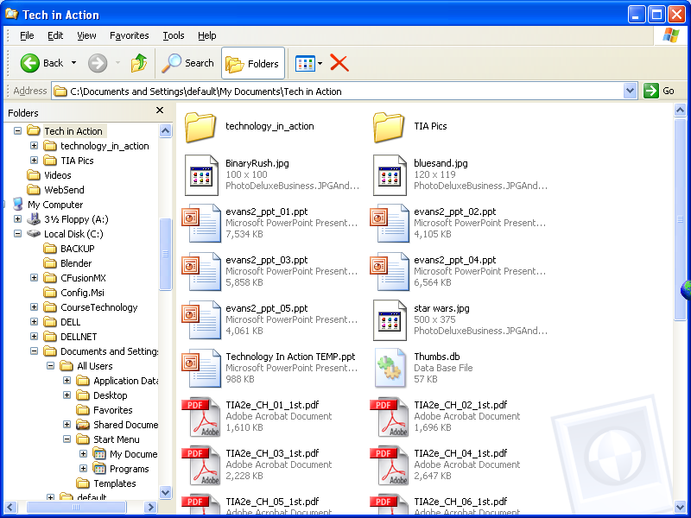
Viewing and Sorting Files and Folders
Windows Explorer
Tiles View
Notes:
Windows Explorer is the main file management utility packaged with the Windows operating system. On the left side of the screen is a graphic representation of the structure of drives and folders. On the right side is a list of files in the selected folder. The program allows you to see the file list a number of ways.
In Windows XP, when you are in a folder, such as My Documents, you can use any of the viewing options located on the View menu to arrange and view your files and folders:
--Tiles view displays files and folders as icons in list form. Each icon includes the filename, the application associated with the file, and the file size.

Slide 26
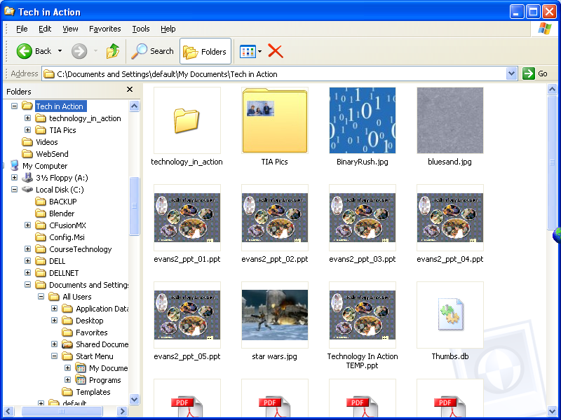
Viewing and Sorting Files and Folders
Windows Explorer
Thumbnail View
Notes:
--Thumbnails view shows the contents of folders as small images. Thumbnails view is therefore the best view to use if your folder contains picture files.

Slide 27
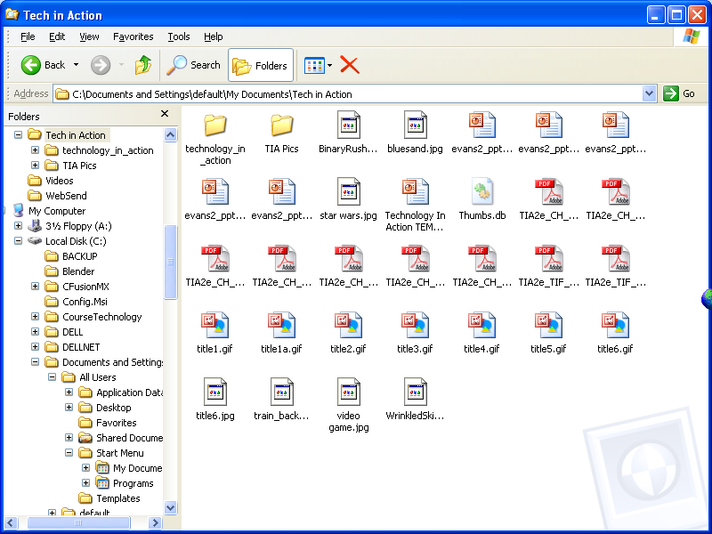
Viewing and Sorting Files and Folders
Windows Explorer
Icon View
Notes:
--Icon view also displays files and folders as icons in list form, but the icons are smaller and include no other file information beside the filename. However, additional file information is displayed when you place your cursor over the file icon.

Slide 28
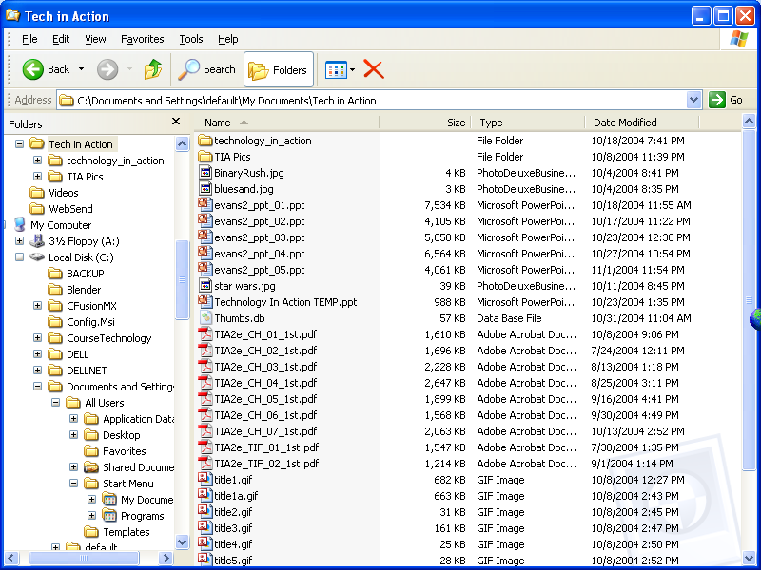
Viewing and Sorting Files and Folders
Windows Explorer
List View
Notes:
--List view is another display of even smaller icons and filenames. This is a good view if you have a lot of content in the folder and need to see most or all of it at once.

Slide 29
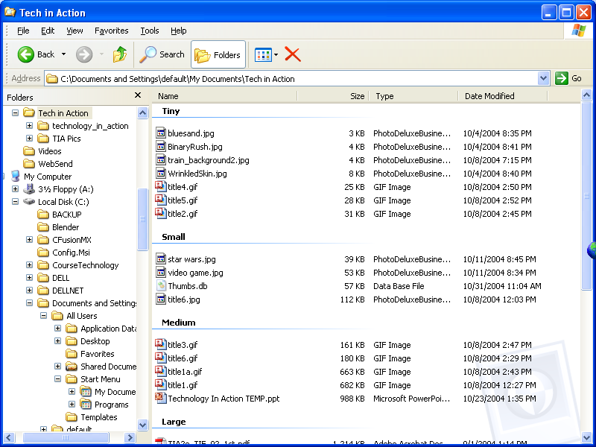
Viewing and Sorting Files and Folders
Windows Explorer
Detail View
Sorted and grouped
Notes:
--In Details view, files and folders are displayed in list form, and the additional file information is displayed in columns alongside the filename. You can sort and display the contents of the folder by any of the column headings.

Slide 30
Naming Files
Filename:
Name assigned plus filename extension
only characters not legal in filenames are: \ ⁄ : * ? " < > ¦
all others are allowed
Bioreport.doc
or
Bio report.doc
Notes:
The first part of a file, or the filename, is the name you assign to the file when you save it. For example, “bioreport” may be the name you assign a report you have completed for biology.
The only characters not legal in filenames now are the forward and back slash , the colon, plus sign, asterisk, question mark, quotation mark, greater than and less than and the vertical line.

Slide 31
File Name Extensions
Filename extensions:
Used by programs
Extension | Type of Document | Application
.doc | Word processing document | Microsoft Word; Corel Word Perfect
.xls | Workbook | Microsoft Excel
.ppt | PowerPoint presentation | Microsoft PowerPoint
.mdb | Database | Microsoft Access
.bmp | Bitmap image | Windows
.zip | Compressed file | WinZip
.pdf | Portable Document Format | Adobe Acrobat
.htm or .html | Web page | Hypertext Markup Language
Notes:
Following the filename and after the dot (.) comes an extension, or file type. This extension identifies what kind of family of files the file belongs to or which application should be used to read the file. For example, if the bioreport file is a Word document, it has a .doc extension and is named bioreport.doc. The table you see here shows different file extensions and the programs associated with them.

Slide 32
File path
File path
Location of the file
Secondary folders
Filename
C:
\My Documents\
Tech in Action\TIA Pics\
dotmatrix.gif
Drive
Primary folder
Notes:
You can tell the location of a file by its file path. The file path starts with the drive in which the file is located, and includes all folders, subfolders (if any), the filename, and extension. For example, if you were saving a picture of Emily Brontë for a term paper for an English Comp course, the file path might be C:\My Documents\Spring 2005\English Comp\Term Paper\Illustrations\EBronte.jpg.

Slide 33
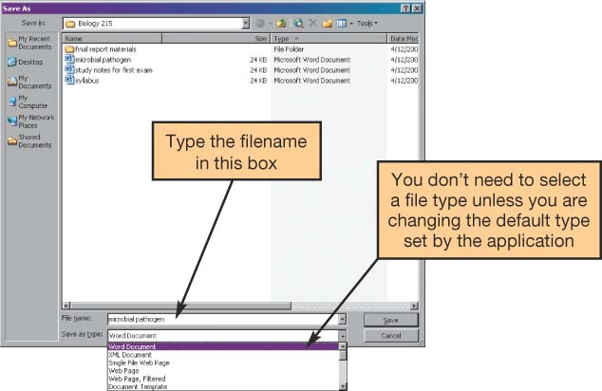
Working with Files
File management actions:
Open
Copy
Move
Rename
Delete
Recycle bin
Saving files
Notes:
Once you’ve located your file with Windows Explorer, you can perform many other file management actions, such as opening, copying, moving, and deleting files.
You open a file by clicking the file in its storage location. The operating system then determines which application needs to be loaded to open the requested file and opens the file within the correct application automatically.
You can copy a file to another location using the Copy command. When you copy a file, a duplicate file is created and the original file remains in its original location.
To move a file from one location to another, you use the Move command. When you move a file, the original file is deleted from its original location.
The Recycle Bin is a folder on the desktop where files deleted from the hard drive reside until you permanently purge them from your system.
Unfortunately, files deleted from other drives, such as the floppy drive, CD, flash drive, or network drive, do not go to the Recycle Bin, but are deleted from the system immediately.

Slide 34
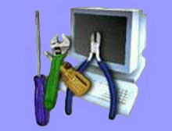
Utility Programs
Small application programs that perform special functions:
Manage system resources
Create pleasant environment
Improve efficiency
Notes:
Utility programs are small applications that perform special functions.
Some utility programs help manage system resources (such as disk defragmenter utilities), others help make your time and work on the computer more pleasant (such as screen savers), and still others improve efficiency (such as file compression utilities).

Slide 35
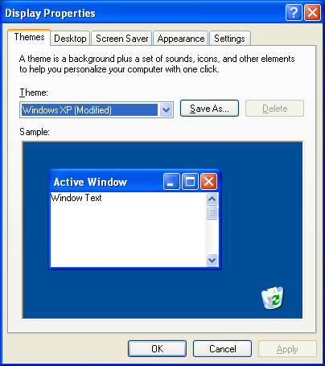
Display Utilities
Change the appearance of:
Desktop
Windows colors
Font sizes
Screen savers
Screen resolution
Notes:
A right click on an open area of the desktop opens the display properties dialogue box. From here you can adjust the look of your Windows environment, change screensavers and even reset the resolution of the video.

Slide 36
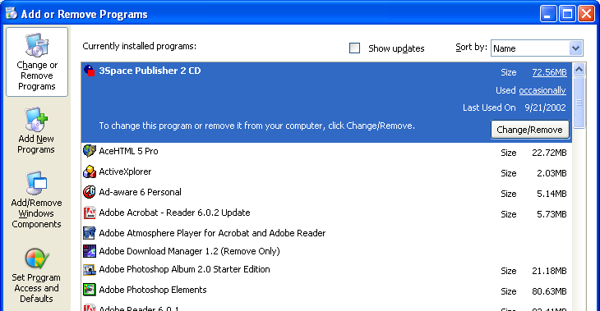
Add or Remove Programs
Installation wizard
Uninstall wizard:
Do not delete programs
Notes:
These days, when you install a new program, the program runs a wizard that walks you through the installation process. If a wizard does not initialize automatically, however, you should go to the Add or Remove Programs folder in the Control Panel. This prompts the OS to look in the CD or floppy disk drive for the setup program of the new software and starts the installation wizard.
Some people think that deleting a program from the Program Files folder on the C drive is the best way to remove a program from the system. However, most programs include support files that are not located in the main program folder. By selecting the Add or Remove Programs icon in Control Panel, you delete the main program file and all supporting files as well.

Slide 37
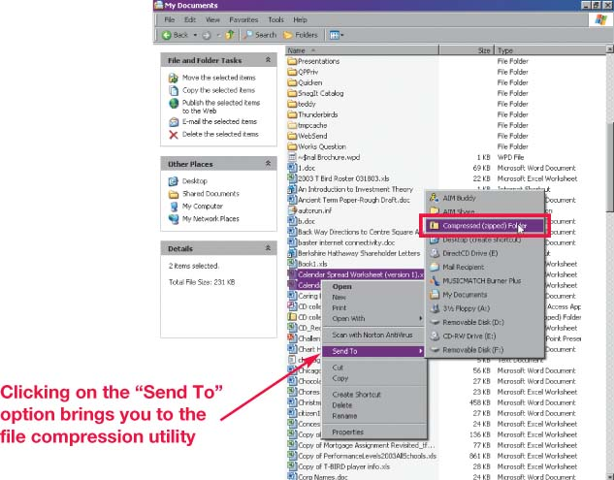
File Compression Programs
Reduce the size of a file:
Removes redundancies
Notes:
A file compression utility is a program that takes out redundancies in a file to reduce the file size.
File compression is helpful because it makes a large file more compact, making it easier and faster to send over the Internet, upload to a Web page, or save onto a disk.
Windows XP has built-in compression (or zip) file support.
There are also several stand-alone freeware and shareware programs, such as WinZip (for Windows) and StuffIt (for Windows or Mac) that you can obtain to compress your files.

Slide 38
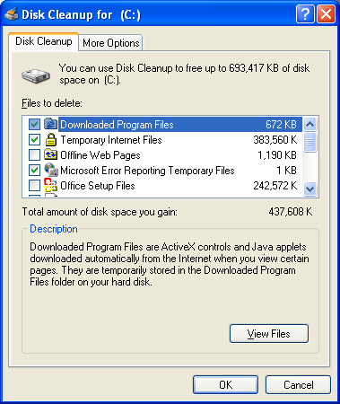
System Maintenance Utilities
Disk cleanup
Cleans unnecessary files
Notes:
A set of maintenance utilities are built into Windows primarily for system efficiency.
Disk Cleanup cleans unnecessary files from your hard drive. These include files that have accumulated in the Recycle Bin as well as temporary files. If not deleted periodically, these unnecessary files can affect performance.
\

Slide 39
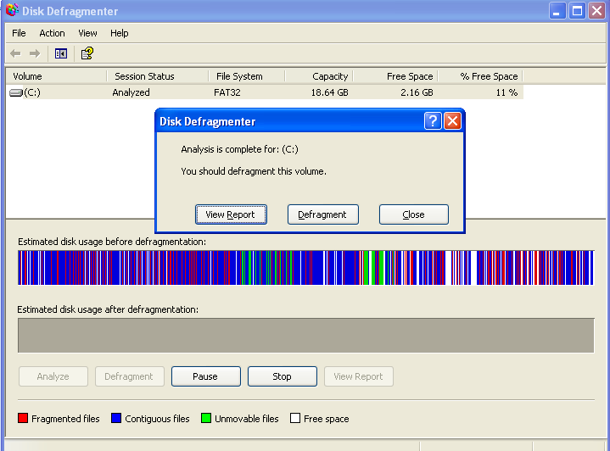
System Maintenance Utilities
Disk defragmenter
ScanDisk:
Error checker
Notes:
Disk defragmenter utilities regroup related pieces of files together on the hard disk, allowing the OS to work more efficiently.
Error-checking, once known as ScanDisk, checks for lost files and fragments as well as physical errors on your hard drive. Sometimes Error-checking can recover the lost data, but more often, it deletes the files that are taking up space unnecessarily.

Slide 40
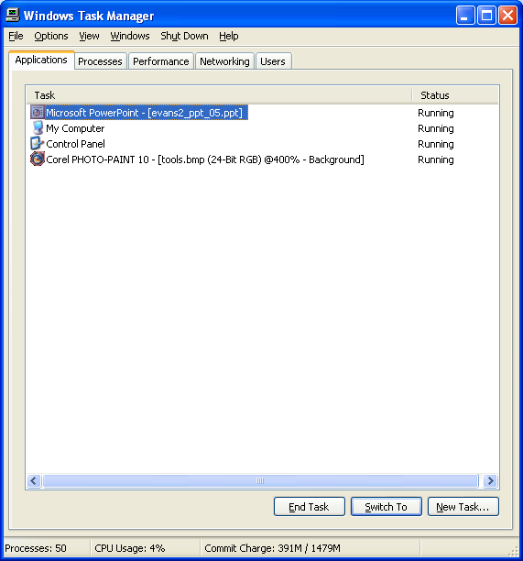
System Maintenance Utilities
Task manager
Notes:
If a program on your system has stopped working, you can use the Windows Task Manager utility to check on the program or to exit the non-responding program.

Slide 41
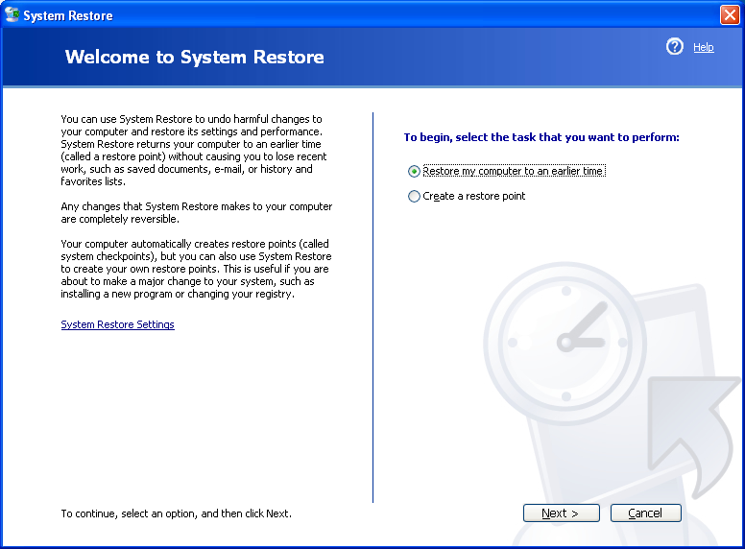
System Restore
System Restore:
Restores the system settings back to a specific date
Notes:
Windows XP has a new utility called System Restore that lets you restore your system settings back to a specific date when everything was working properly.

Slide 42
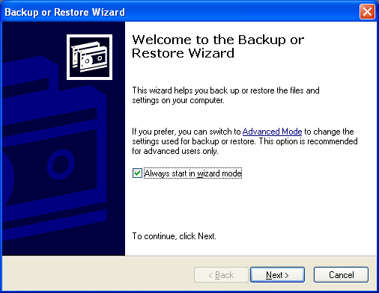
System Backup
Backup:
Creates a copy of the hard drive to another storage device
Task Scheduler
Sets a time to run selected utilities automatically
Notes:
When you use the Windows Backup utility, you create a duplicate copy of all the data on your hard disk and copy it to another storage device, such as a CD or external hard drive.
The Windows Task Scheduler utility allows you to schedule tasks to run automatically at predetermined times, with no interaction necessary on your part.

Slide 43
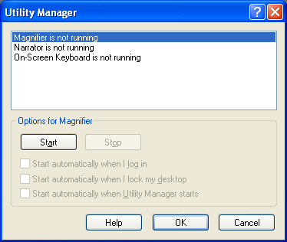
Accessibility Utilities
Utility manager:
Magnify screen image
Screen contents narration
On-screen keyboard
Notes:
Utility Manager is a utility that enables you to magnify the screen image, have screen contents read to you, and display an on-screen keyboard.

Slide 44
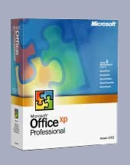



Software
A set of instructions that tells the computer what to do
Two main types of software
System software
Application software
System Software
Application Software
Notes:
The term software refers to a set of instructions that tells the computer what to do. These instruction sets, also called programs, provide a means for us to interact with and use the computer.
Your computer has two basic types of software: system software and application software.

Slide 45
System Software vs. Application Software
System Software
Coordinates instructions between software & hardware
Includes
Operating system
Utility programs
Application Software
Programs used to complete tasks
Includes
Productivity software
Specialty software
Entertainment Software
Educational and Reference Software
Personal Software
Notes:
System software helps run the computer and coordinates instructions between application software and the computer’s hardware devices. System software includes the operating system , utility programs (programs often in the operating system that help manage system resources) and device drivers.
Application software is what you use to do tasks at home, school, and work.

Slide 46
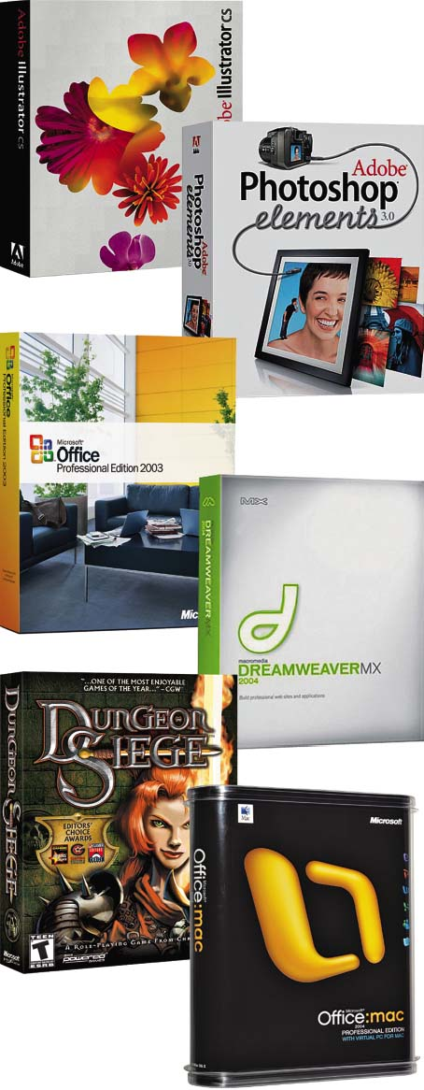
Application Software
Productivity software
Specialty software
Entertainment Software
Educational and Reference Software
Personal Software
Notes:
Here you see the various types of application software available. In this chapter, we look at all of these types in detail, starting with productivity software.

Slide 47
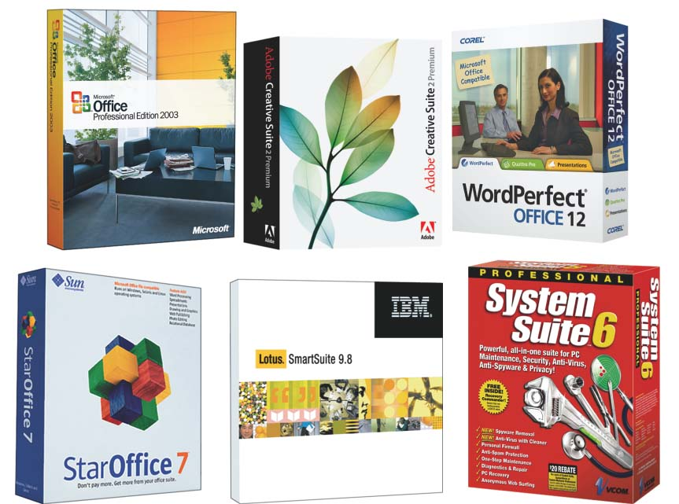
Productivity Software
Programs that enable you to perform tasks required in home, school, and business
Word processing programs
Spreadsheet programs
Presentation programs
Database programs
Personal information manager programs
Notes:
Productivity software includes programs that enable you to perform various tasks generally required in home, school, and business. This category includes word processing, spreadsheet, presentation, database, and personal information manager (PIM) programs..
The most used is Microsoft Office consisting of a Word Processing program called Word, a spreadsheet program called Excel, a presentation program called PowerPoint , a database program called Access, and a PIM called Outlook.

Slide 48
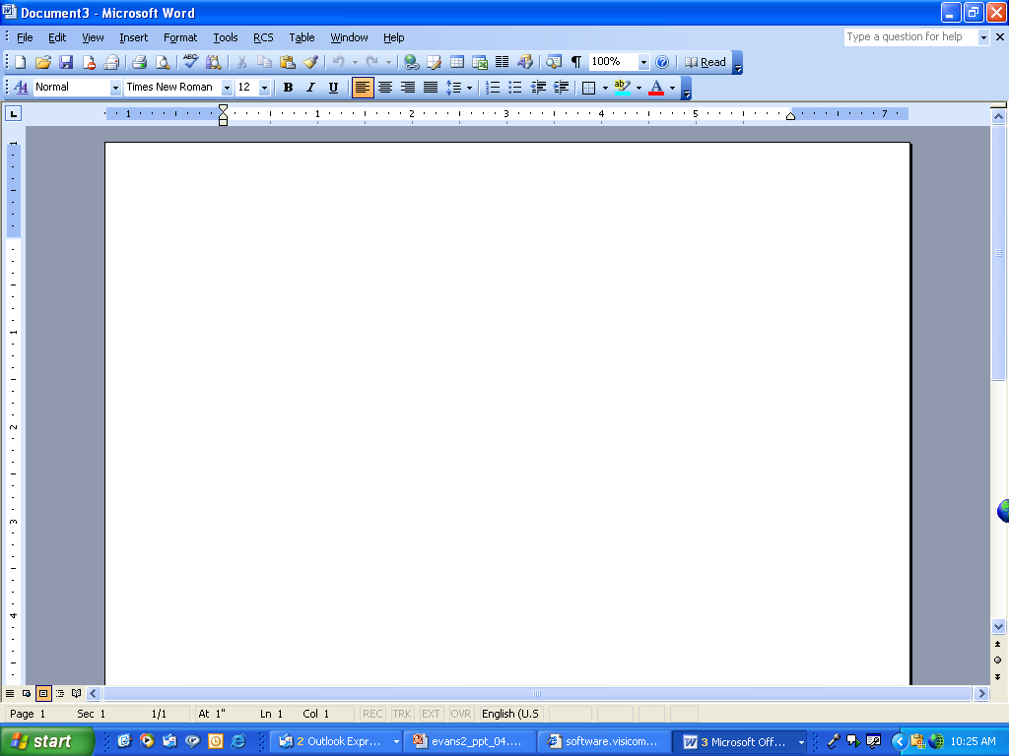




Word Processing Software
Used to create and edit written documents
Features include
Quick and easy editing
Variety of formatting options
Graphics
Templates
Examples
Corel Word Perfect
Microsoft Word
Word Processor Features
Click to view
Sammy the WonderDog
Create Tables
Insert Excel Spreadsheets
Use Templates
Insert Graphics
Notes:
Word processing software was one of the early applications that turned the computer into a necessity. It offers very powerful features to help write and edit all kinds of documents. Today’s word processors incorporate graphics, templates, and wizards that allow users to create a wide range of document types.
Microsoft Word and Corel’s WordPerfect are popular word processing programs.

Slide 49





Spreadsheet Software
Used to perform calculations and numerical analyses
Features include
Worksheets with cells
Values, formulas, and functions
Automatic recalculation
Examples
Lotus 1-2-3
Microsoft Excel
Charts
Rows
Spreadsheet Features
Click to view
Worksheet
Cell
Labels
Values
Formulas
Functions
Columns
Range of cells
Notes:
Spreadsheet software enables you to do calculations and numerical analyses easily. You can use spreadsheet software to create a budget, and to evaluate different scenarios such as planning a loan payment strategy.
The basic element in a spreadsheet program is the worksheet, whose columns and rows form boxes called cells. There are several types of data you can enter into a cell:
-Labels are descriptive text that identifies the components of the worksheet.
-Values are numeric data either entered in directly or as a result of a calculation.
-Formulas are equations that you build yourself.
-Functions are formulas that are preprogrammed into the spreadsheet software.
The primary benefit of spreadsheet software is its ability to recalculate all functions and formulas in the spreadsheet automatically when assumptions are changed.
Examples of spreadsheet software include Microsoft Excel and Lotus 1-2-3,

Slide 50



Presentation Software
Used to create slide shows
Features include
Templates and layouts
Different views
Examples
Corel Presentations
Microsoft PowerPoint
Task Pane
Slide Title
Presentation Software Features
Click to view
Graphics
Bulleted Text
Slide/Outline View
Work Area
Background
Slide Show View
Speaker Notes
Notes:
You use presentation software to create dynamic presentations such as this one.
Basic features include a variety of slide layouts and design templates, preformatted slide backgrounds that add coordinated colors, fonts, and styles to your slides.
You can use animation effects to control how and when text and other objects enter and exit each slide. Similarly, slide transitions add different effects as you move from one to the next during the presentation..
There are several different formats with which you can view your presentation. The most common for editing is Normal (or Slide) view.
Examples of presentation software include Microsoft PowerPoint and Corel Presentations

Slide 51

Database Software
Used as a complex electronic filing system
Features include
Ability to group, sort, and retrieve data and generate reports
Organized into fields, records, and tables
Examples
Corel Paradox
Microsoft Access
Notes:
Database software is basically a complex electronic filing system.
Spreadsheet applications include many database features and are easy to use for simple database tasks such as sorting, filtering, and organizing data. However, you need to use a more, full-featured database application to manage larger and more complicated groups of data that contain more than one table or when you need to group, sort, and retrieve data and to generate reports.
Traditional databases are organized into fields, records, and tables. A field is a data category such as “First Name.” A record is a collection of related fields. A table groups related records together.
Examples of database software include Corel Paradox and Microsoft Access

Slide 52

Personal Information Manager Software
Used to replace the management tools found on a traditional desk
Features include
Calendar, address book, notepad, to-do list
Some contain e-mail management features
Examples
Lotus Organizer
Microsoft Outlook
Notes:
Most productivity software suites contain some form of personal information manager (PIM) software. These programs strive to replace the management tools found on a traditional desk, such as a calendar, address book, notepad, and to-do list.
Some PIMs contain e-mail management features so that you can not only receive and send e-mail messages, but also organize them into various folders, prioritize them, and coordinate them with other activities in your calendar.
PIM examples include as Microsoft Outlook and Lotus Organizer.

Slide 53




Productivity Software Tools
Wizards
Step-by-step guides to help you complete a task
Notes:
Whether you are working on a word document, spreadsheet, database, or slide presentation, there are several tools you can use to increase your efficiency:
Wizards are step-by-step guides that walk you through the necessary steps to complete a complicated task. At each step, the wizard asks you questions. Based on your responses, the wizard helps you complete that portion of the task.
Templates are forms included in many productivity applications that provide the basic structure for a particular kind of document, spreadsheet, or presentation.
Macros are small programs that group a series of commands to run as a single command. Macros are best used to automate a routine task or a complex series of commands that must be run frequently.

Slide 54


Productivity Software Tools
Templates
re-designed forms included with software

Slide 55

Productivity Software Tools
Macros
Small programs that group a series of commands to run as a single command

Slide 56


Integrated Software Applications vs. Software Suites
Integrated Applications
Single program that incorporates many software programs
Complex features are not included
Example: Microsoft Works
Software Suites
Collection of stand-alone software programs packaged together
Notes:
An integrated software application incorporates the most commonly used tools of many productivity software programs into one integrated stand-alone program. They don’t include many of the more complex features of the stand-alone productivity software applications.
Microsoft Works is an example of an integrated software application.
A software suite is a group of software programs that have been bundled together as a package. You can buy software suites for many different categories of applications, including productivity, graphics, and virus protection.
Microsoft Office is just one example of the many types of software suites on the market today. You can also buy different versions of the same suite, the difference being the combination of software applications included in each version.

Slide 57
Financial and Business-Related Software
Personal financial software
General business software
Specialized business software
Notes:
Financial and business-related software can be grouped into three main categories:
Personal financial software that helps you perform businesslike tasks at home, such as preparing your taxes and managing your personal finances
General business software used in different capacities across industries
Specialized business software designed for particular industries

Slide 58




Personal Financial Software
Used to for tax preparation, financial planning, and personal accounting
Examples
TurboTax and H&R Block’s TaxCut
Intuit’s Quicken and Microsoft Money
Intuit’s QuickBooks and Peachtree Accounting
Notes:
Tax-preparation software enables you to prepare your taxes on your own rather than having to hire a professional. Each program offers a complete set of tax forms and instructions as well as expert advice on how to complete each form. Examples include Intuit’s TurboTax and H&R Block’s TaxCut
Financial planning software helps you manage your daily finances. These programs include electronic checkbook registers and automatic bill payment tools. With these features, you can print checks from your computer or pay your regular monthly payments with automatically scheduled online payments or printed checks. Intuit’s Quicken and Microsoft Money are popular examples.
Accounting software helps small business owners manage their finances more efficiently by providing tools for tracking accounts receivable and accounts payable. In addition, these applications also offer inventory management plus payroll and billing tools. Examples of accounting software include Intuit’s QuickBooks and Peachtree Accounting.

Slide 59
General Business Software
Used across a variety of industries
Includes
Business and marketing plan software
Project management software
Mapping programs
Customer relationship management (CRM) software
Enterprise Resource Planning (ERP) systems
Notes:
There are specialized programs for a number of important business tasks, like writing business and marketing plans.
Project management software such as Microsoft Project helps project managers easily create and modify scheduling charts so they can plan and track specific project tasks and coordinate personnel resources..
Mapping programs such as Rand McNally’s StreetFinder are perfect for businesses that require a lot of travel.
Customer relationship management (CRM) software is used to store sales and client contact information in one central database. Sales professionals use CRM programs to get in touch and follow up with their clients. GoldMine Business Contact Manager from FrontRange Solutions is an example of a CRM program.
Enterprise Resource Planning (ERP) systems are used to control many “back office” operations and processing functions such as billing, production, inventory management, and human resources management. ERP systems are implemented by third-party vendors and matched directly to the specific needs of a company.

Slide 60

Specialized Business Software
Tailored to the needs of a particular company or industry
Called vertical market software
Proprietary software
Programs custom developed to address the specific needs of a particular company.
The software is then owned by that company.
Notes:
Some software applications are tailored to the needs of a particular company or industry. Such software designed for a specific industry is called vertical market software.
For example, the construction industry uses software such as Intuit’s Master Builder, which features estimating tools to help construction companies bid on jobs. Other examples of vertical market software include property management software for real estate professionals and library automation software for cataloging, circulation, inventory, and custom report printing at libraries.
In addition to these specific business software applications that companies can buy off the shelf, programs are often custom developed to address the specific needs of a particular company. These custom applications are often referred to as proprietary software because they are owned and controlled by the company that uses them.

Slide 61

Graphics and Multimedia Software
Used to create and design documents, images, illustrations, Web pages, and more
Notes:
Graphics software encompasses a wide range of programs home users and professionals alike use to design and create attractive documents, images, illustrations, and Web pages. In addition, graphics software allows engineers and other professionals to create three-dimensional models and drawings to help them visualize construction plans.
Graphics software is a part of a larger group of software: multimedia software. Multimedia software includes video and audio editing software, animation software, and other special software required to produce computer games.

Slide 62

Desktop Publishing Software
Used to arrange text and graphics for publications
Features include
Text formatting
File importing
Graphics tools
Web publishing
Example: Quark
Notes:
Desktop publishing (DTP) software allows you to incorporate and arrange graphics and text in your documents in creative ways.
Desktop publishing programs offer a variety of tools with which you can format text and graphics. You can easily change the font, size, and style of your text as well as arrange text on the page in different columns, shapes, and patterns. You can import files into your documents from other sources and manipulate graphics. Desktop publishing programs also include features that allow you to publish to the Web.
Examples include as QuarkXPress and Adobe PageMaker

Slide 63

Image-Editing Software
Used to edit photographs and other images
Also called photo-editing software
Features include
Tools for basic modifications to digital images
Painting tools that allow you to create images
Example: Adobe Photoshop
Notes:
Image-editing software (sometimes called photo-editing software) enables you to edit photographs and other images.
Image-editing software includes tools for basic modifications to digital images such as removing red-eye, modifying color hues, and removing scratches or rips from scanned images of old photos.
Many of these software packages now also include an extensive set of painting tools such as brushes, pens, and artistic-type mediums that allows you to create realistic-looking images as well.
Adobe Photoshop is a full-featured image-editing software application. Other image-editing programs are geared to the casual home user and are included with digital cameras.

Slide 64

Drawing Software
Used to create and edit
Two-dimensional drawings
Technical diagrams
Animations
Geometric shapes
Also referred to as illustration software
Examples
Adobe Illustrator
Microsoft Visio
Bit-mapped programs
MS-Paint
Notes:
Drawing software (or illustration software) lets you create or edit two-dimensional line-based drawings such as technical diagrams or original nonphotographic drawings, animations, and illustrations using standard drawing and painting tools such as pens, pencils, and paintbrushes.
Software applications such as Adobe Illustrator include tools that let you create professional-quality illustrations.
Microsoft Visio is a program used to create technical drawings, maps, basic block diagrams, networking and engineering flowcharts, and project schedules.
MS-Paint and other bit-mapped programs allow creation of drawings that can be saved as bit-mapped files such as .bmp, .gif and .jpg.

Slide 65

Computer-Aided Design Software
Used to create 3-D automated designs, technical drawings, and model visualizations
Industrial use includes
Architecture
Automotive
Aerospace
Medical engineering
Notes:
Computer-aided design (CAD) programs are a form of 3-D modeling that engineers use to create automated designs, technical drawings, and model visualizations.
Specialized CAD software is used in industries such as architecture, automotive, aerospace, and medical engineering.
With CAD software, architects can build virtual models of their plans and readily visualize all aspects of design prior to actual construction.
The 3-D nature of these programs allows engineers to rotate the model and make adjustments to their designs where necessary, thus eliminating costly building errors.

Slide 66

Video-Editing Software
Used to edit digital videos
Features include
Special effects
Transitions
Narration/voiceover
Overlays
Examples
Adobe Premiere
Microsoft Movie Maker
Notes:
Digital video–editing software is used to edit digital videos.
Features include special effects, transitions, narration/voiceover, and overlays.
Although the most expensive products (like Adobe Premiere) offer the widest range of special effects and tools, there are some moderately priced video-editing programs, such as Microsoft Movie Maker.

Slide 67


Web Page Authoring Software
Used to design Web pages: knowing HTML is not necessary
Features include
Wizards and templates
Reference materials
Examples
Microsoft FrontPage
Macromedia Dreamweaver
Notes:
Web page authoring software allows even the novice user to design interesting and interactive Web pages, without knowing any HTML code.
Web page authoring applications often include wizards, templates, and reference materials to help you easily complete most Web page authoring tasks.
Microsoft FrontPage and Macromedia Dreamweaver are two of the leading programs to which both professionals and casual Web page designers turn.

Slide 68
Educational and Reference Software
Educational Software
Provides instruction or training
Types include
K-12 education
Skills
Test preparation
Course management
Reference Software
Sources of reference
Types include
Atlases, dictionaries, thesauri, encyclopedias
Medical and legal references
Notes:
Educational software refers to the variety of software applications on the market that offer some form of instruction or training.
Software applications that act as sources for reference materials, such as the standard atlases, dictionaries, and thesauri, are referred to collectively as reference software.

Slide 69

Course Management Software
Used for Web-based classes
Features include
Calendars
Grade books
Discussion boards
Examples
WebCT
Blackboard
Notes:
Taking classes over the Internet is fast becoming a popular method of learning because it offers greater schedule flexibility for busy students.
These programs provide traditional classroom tools such as calendars and grade books over the Internet. There are also special areas for students and their professor to exchange ideas and information in chat rooms, discussion forums, and e-mail messages. Of course, there are areas where assignments, lectures, and other pertinent class information are available.
Although some courses are run from an individually developed Web site, many online courses are run through course management software programs such as Blackboard and WebCT.

Slide 70

Entertainment Software
Designed to provide users with entertainment
Categories include
Action and Adventure
Driving
Puzzles and strategy
Role-playing
Card-playing
Simulation
Virtual reality
Notes:
Entertainment software is designed to provide users with entertainment. Computer games make up the vast majority of entertainment software.
Virtual reality programs turn an artificial environment into a realistic experience.

Slide 71

Digital Audio Software
MP3: Audio compression format
Software allows you to record, rip, and burn files
Also allows you to perform format conversion
Notes:
MP3 is the audio compression format that reduces the file size of traditional digital audio files so more files take up less storage capacity.
Hundreds of digital audio software applications are available to allow you to copy (or rip), play, edit, and organize MP3 files, as well as to record and distribute your own music online. Most digital audio software programs support one of the following functions.
MP3 recording: Allows you to record directly from streaming audio and other software or microphone sources to MP3 format.
Ripping: Allows you to copy CDs and encode them to MP3 format.
MP3 burning: Allows you to record MP3 files onto a CD.
Encoding and decoding/format conversion: Encoders are programs that convert files to MP3 format at varying levels of quality. Decoders/format conversion programs convert from one format to another.

Slide 72
Communications Software
Using a computer and software to communicate to others
Groupware
Software used to connect people at different locations
Videoconferencing/Web conferencing
Transmitting audio and video data over a network
Telephony
Transmitting telephone calls over the Internet
Known as Voice over Internet Protocol (VoIP)
Notes:
The advent of the computer and other technologies has broadened our ability to communicate with each other beyond the standard phone call and written letter. Today, we have other means of communications available that combine computer hardware and software.
Groupware is software that helps people who are in different locations work together using e-mail and online scheduling tools. Lotus Notes from IBM and Novell’s Groupwise are two popular groupware solutions.
Videoconferencing involves the transmission of audio (voice) and video (picture) data over computer networks. Videoconferencing systems can be quite complex or as simple as a computer setup enhanced with a camera on top of a monitor, microphone, and speakers.
Web conferencing is another form of group communications that allows you to conference with anyone, anywhere over the Internet
Telephony technology, often referred to as Voice over Internet Protocol (VoIP), is the transmission of telephone calls over the Internet.

Slide 73

Getting Help with Software
Types of help
Frequently asked questions (FAQs)
Online help and support
ScreenTips
Microsoft Office Assistant
Help menu
Notes:
If you need help while you work with software, there are several different resources you can access to find answers to your questions.
For general help or information about the product, many Web sites offer frequently asked questions (FAQs) for answers to the most common questions.
Some programs also offer online help and support. Sometimes, online help also allows you to chat with a member of an online support team.
Some applications are context-sensitive and offer help based on what task you’re doing or ScreenTips to explain where your cursor is resting.
In Microsoft Office applications, you’ll find the Ask a Question box in which you can type your question. The Office Assistant, generally an animated paper clip (also known as Clippit), provides tips on tasks while you’re working or answers your specific questions.
There is the Help menu on the menu bar of most applications where you can choose to search an index or content outline to find out the nature of almost any feature of a Microsoft application.

Slide 74
Buying Software
Software may be purchased through
Retail stores
Online
Computer shows
Catalogs
Preinstalled software
Student discounted software
Notes:
You can find software in almost any retail environment. Additionally, you can purchase software online, through catalogs, or at auctions.
Virtually every new computer comes with some form of application software, though the applications depend on the hardware manufacturer and computer model. You can usually count on your computer having some form of productivity software preinstalled.
If you’re a student or an educator, you can purchase software that is no different from regularly priced software at prices that are sometimes substantially less than general consumer prices.
Software purchased online is downloaded over the web and then installed.

Slide 75

Freeware and Shareware
Freeware: Copyrighted software you can get for free
Beta versions: Programs that are still under development
Shareware: Software that allows users to run it for a limited time free of charge
Notes:
Freeware is any copyrighted software that you can use for free.
Some software developers offer beta versions of their software free of charge. Beta versions are still under development. By distributing free beta versions, developers hope to have users report errors or bugs they find in the program. This helps the developers correct any errors before they launch the software on the market at retail prices.
Software that allows users to test software (run it for a limited time free of charge) is referred to as shareware. Shareware is not freeware. If you use the software after the initial trial period is over, you will be breaking the software license agreement.

Slide 76

Software Versions
Software versions
Numbers used to represent major and minor upgrades
Major upgrade – Version 2.0
Minor upgrade – Version 2.1
Notes:
Software developers sometimes change their software programs to repair problems (or bugs) or to add new or upgraded features. Generally, they keep the software program’s name but add a number to it to indicate it is a different version.
Originally, developers used numbers only to indicate different software versions (major upgrades) and releases (minor upgrades). Today, however, software developers also use years (such as Office 2003) and letters (Windows XP) to represent a version upgrade.

Slide 77
System Requirements
Minimum standards for the operating system, RAM, and hard drive capacity
Sample Minimum System Requirements
IBM compatible PC with a 486 PC processor or better (Pentium® recommended)
Microsoft Windows® 95
12 MB RAM (16 MB recommended)
Hard disk space (standard installation approx. 100 MB)
CD-ROM drive (2x or better)
Mouse or other pointing device
Notes:
Every software program has a set of system requirements that specify the minimum recommended standards for the operating system, processor, primary memory (RAM), and hard drive capacity. Sometimes there are other specifications for the video card, monitor, CD drive, and other peripherals. These requirements are generally printed on the software packaging or at the publisher’s Web site.
Before installing software on your computer, ensure your system setup meets the minimum requirements by having sufficient storage, memory capacity, and processing capabilities

Slide 78
Installing/Uninstalling and Opening Software
Installing software
Installation wizard
Automatic
Control Panel: Add/Remove Software
Full/custom installation
Uninstalling software
Software uninstall program
Control Panel: Add/Remove Software
Do not delete
Opening software
Start menu
Quick launch toolbar
Desktop shortcut
My Computer/Windows Explorer
Notes:
When you buy software, you insert the CD that contains the program files, and for most programs being installed on a PC, an installation wizard automatically opens. By simply following the steps indicated by the wizard, you can install the software application on your system.
If for some reason the wizard doesn’t open automatically, the best way to install the software is to go to the Add/Remove Programs icon located in Control Panel on the Start menu. This feature locates and launches the installation wizard.
One of the first steps in the installation wizard is deciding between a full installation and a custom installation. A full installation will copy all the files and programs from the CD to your hard drive. By selecting custom installation, you can decide which features you want installed on the hard drive.
Uninstalling software in Windows requires using the Uninstall utility found in the Control Panel. Most software programs load a series of files into the registry and system locations to support their operation. When uninstalling, all of these files need to be removed and the only good way to do this is through the uninstall utility.
Once a software program is installed.,Windows has a number of alternatives for activating it. It can load from a desktop icon shortcut, or its icon can be placed in the Quick launch toolbar. Alternatively all programs can be located through the Windows start menu and even finding the executable file using Windows Explorer or My Computer and double clicking will activate an installed program.

Slide 79
NOW

